Slide 1
All-Scale Trajectory Clustering for Moving Behavior Detection with Spatiotemporal Recurrent Convolutional Neural Networks¹
Yao-Yi Chiang*
Associate Professor
Computer Science and Engineering
University of Minnesota
yaoyi@umn.edu
¹ An NGA Boosting Innovative GEOINT (BIG) project
*With Cyrus Shahabi and Mingxuan Yue, University of Southern California

Slide 2
OUTLINE
Overview
Approach: DETECT
Convert trajectories to sequences of contexts
Fixed-size representation (embedding) with RNN
Embedding Clustering and Optimization
Experiments
Future Work

Slide 3










Motivation
COVID 19
User Profiling
Recommendations
Ads targeting
Insurance
Threats Detection
Mobility behavior:
travel activity describing a user’s movements, e.g., work commute, shopping, school commute, dining
Mobility Behavior

Slide 4





Idea
Trajectories
Clusters
Mobility Behavior

Slide 5
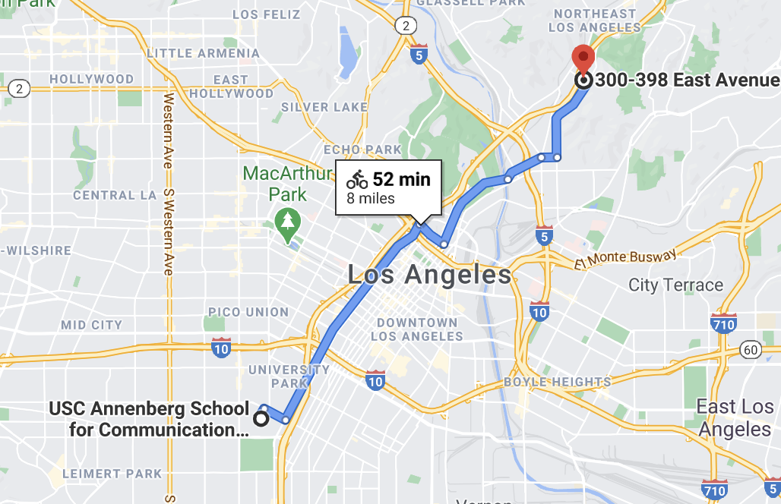
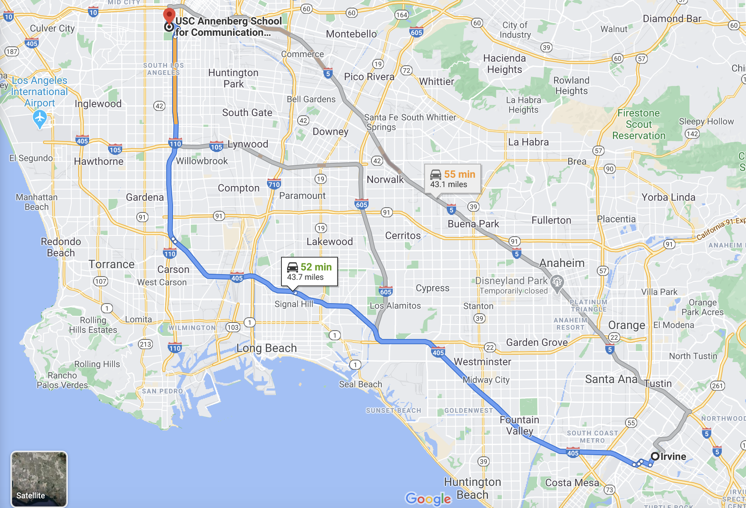
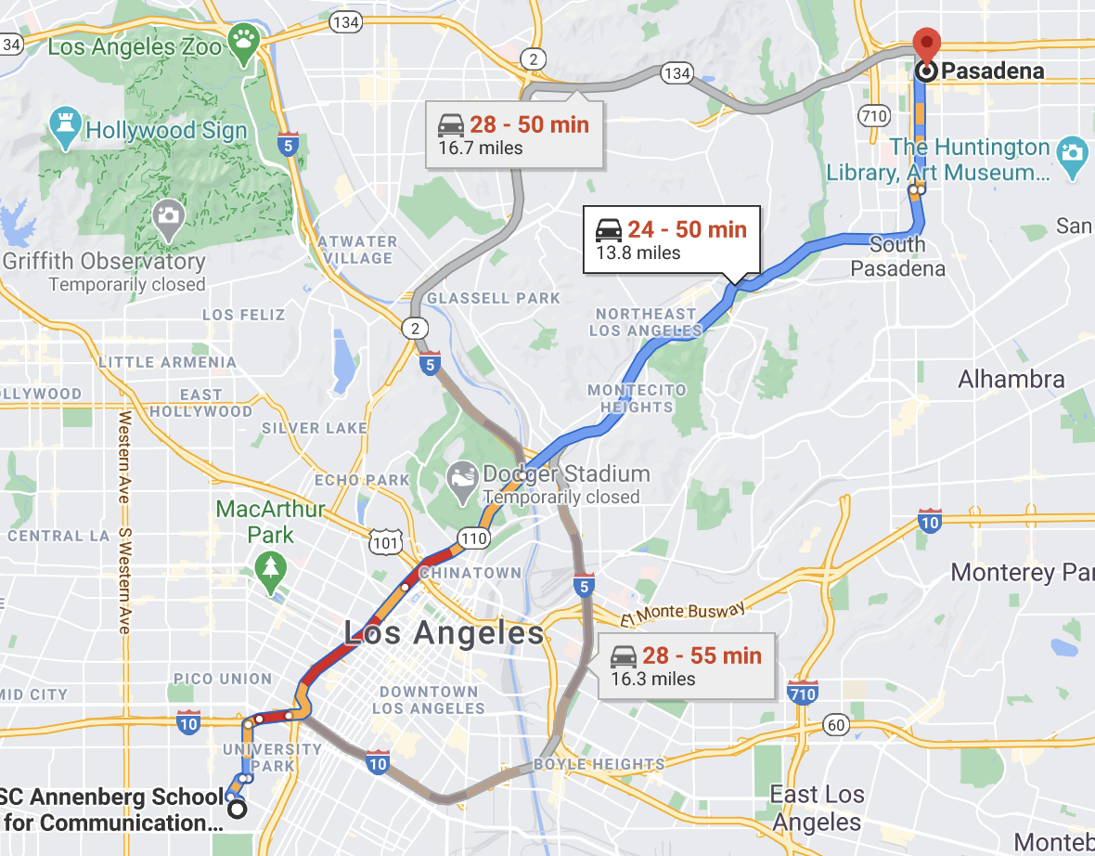
Challenge: Multi-scale Trajectories
Various temporal and spatial scales may represent the same mobility behavior
50 minutes work commute:
14 miles, 44 miles, 8 miles
14 miles work commute
20 min, 50 min, 1.5 hour

Slide 6
Trajectory Clustering Techniques
Based on similarity of raw spatiotemporal features [AIR’17]
Sequence distance measurement
Dynamic Time Warping (DTW), Longest Common SubSequence (LCSS)
Clustering based on the distances
kMeans-DBA[ICDM’14], DBSCAN[CVPR’09], Hierarchical Clustering
Notes:
There are some traditional ways to do trajectory clustering. These approaches mostly rely on raw spatio temporal features. They usually define some distance measurement between the trajectories to measure kind of how topologically similar these trajectories are. For example, the DTW distance …, And then they use or adapt some classical clustering techniques based on the distance to do the clustering task.
kMeans using DTW distance. DBA is a special way to calculate centers for DTW distnce.

Slide 7


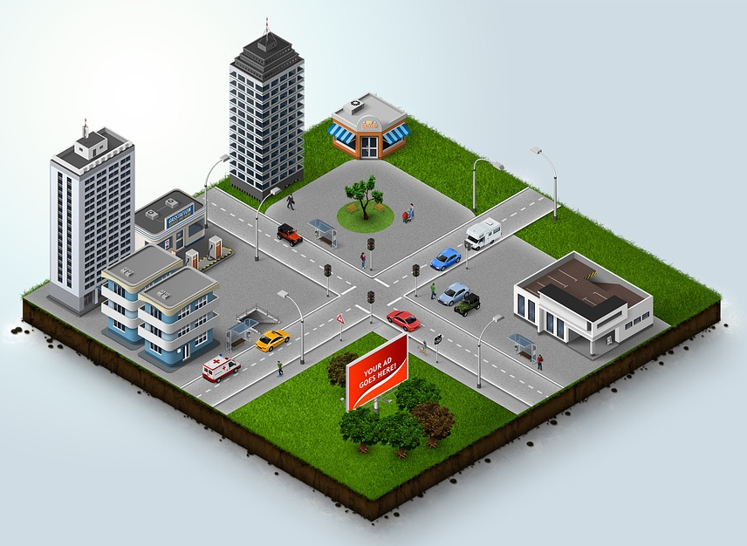
Limitations of Traditional Trajectory Clustering Techniques
Prone to scales & noises
No activity context information
Pre-defined similarity vs. data-driven
Notes:
Second, the traditional approaches do not consider context… So they will not know my colleague in UCLA is also making a work commute like me if they don’t know that place is a school. And, the last point is the similarity they define are always predefined rule, like … which is not driven by the data.

Slide 8
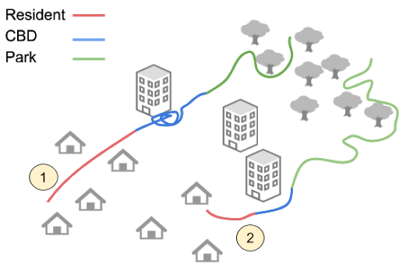
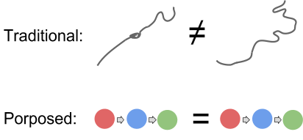
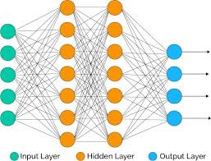
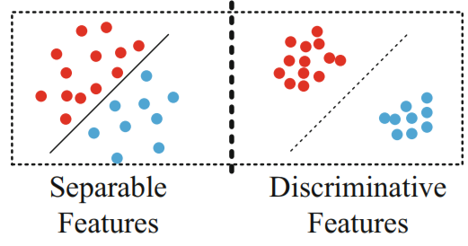
DETECT: Deep Trajectory Clustering for Mobility-Behavior Analysis
Address varying spatial & temporal scales
Aware of geographical context
Work for variable lengths of sequences
Learn useful properties driven by data
Avoid expensive manual labeling
Convert trajectories to sequences of contexts
Fixed-size representation (embedding) with RNN
Embedding Clustering and Optimization

Slide 9
OUTLINE
Overview
Approach: DETECT
Convert trajectories to sequences of contexts
Fixed-size representation (embedding) with RNN
Embedding Clustering and Optimization
Experiments
Future Work

Slide 10

Approach
DETECT [BigData 19]
All-scale
Context-aware
Sequence Dynamics
Yue, M., Li, Y., Yang, H., Ahuja, R., Chiang, Y.-Y., and Shahabi, C. (December 2019). DETECT: Deep Trajectory Clustering for Mobility-Behavior Analysis. In Proceedings of the 2019 IEEE International Conference on Big Data (Big Data), pp. 988–997, Los Angeles, CA, USA

Slide 11




All-scale: Stay Points
Stay points [SIGSPATIAL’08] are meaningful locations where:
the user travels within a small range of space
the user stays in this range for some time

Slide 12
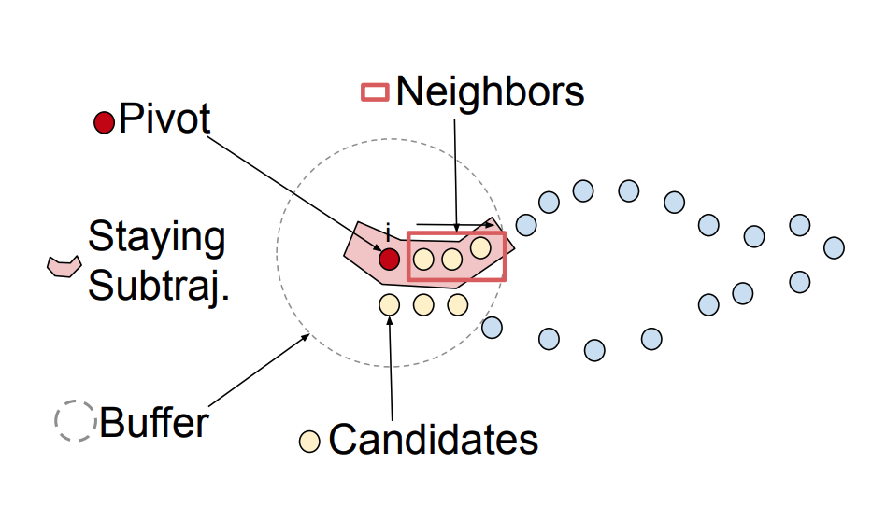
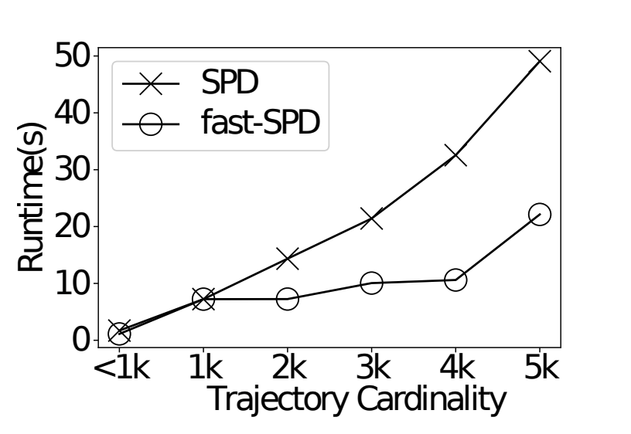
All-scale: Fast Stay Point Extraction
Fast-SPD:
Scan each trajectory to find consecutive sub-trajectories that the user travel within a limited range but stay for a long time
Use the centers of such sub-trajectories as stay points

Slide 13
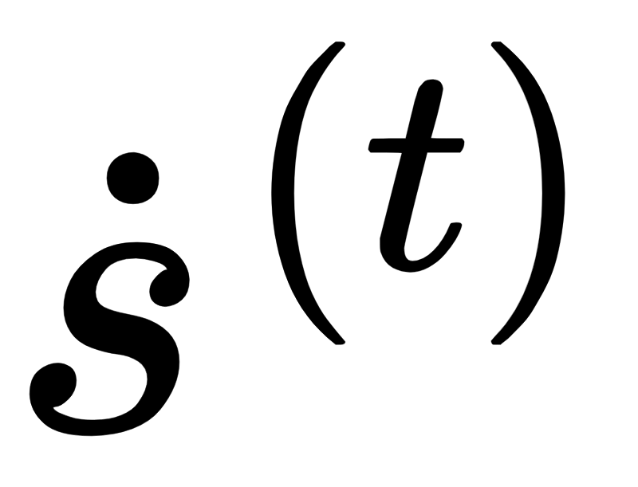
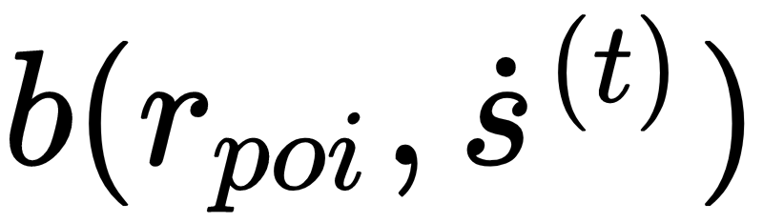
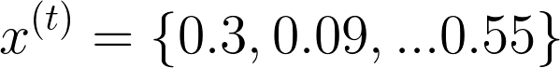
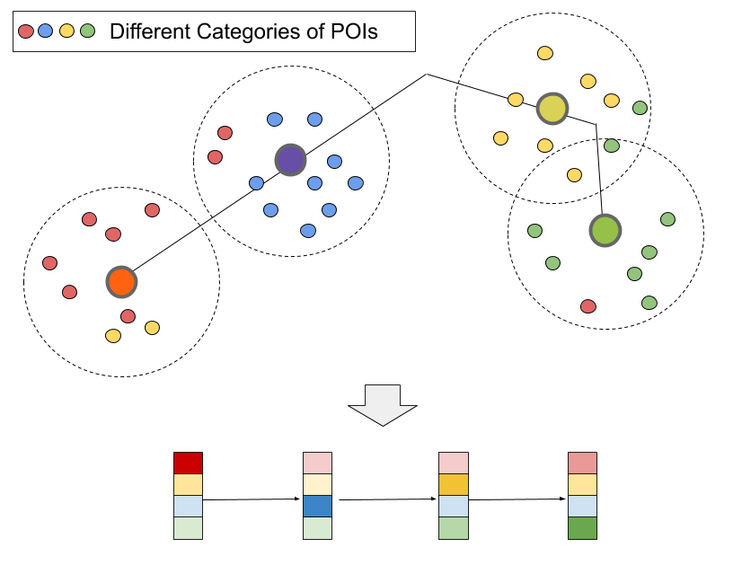
Context-aware: Geographical Augmentation
For each extracted stay point :
create a spatial buffer
search a gazetteer for POI’s in the buffer
count POIs in the buffer
generate a normalized vector
Normalized number of POI categories, e.g., business area
Notes:
Count POIs with their categories such as resident, restaurants, park

Slide 14
OUTLINE
Overview
Approach: DETECT
Convert trajectories to sequences of contexts
Fixed-size representation (embedding) with RNN
Embedding Clustering and Optimization
Experiments
Future Work

Slide 15
Sequence Dynamics: RNN-AE + Clustering
Phase I:
Phase II:

Slide 16




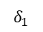
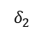
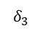



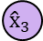



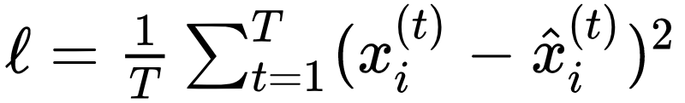
Phase I: RNN Autoencoder
Encoder
Decoder
Reconstructed Feature
Input feature
RNN
RNN
RNN
RNN
RNN
RNN
Trajectory Representation
Input
Loss function:

Slide 17
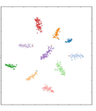
Phase II: Refine for clean clusters
RNN-AE (Phase I）
Clustering layer (Phase II)
Input feature
RNN
RNN
RNN
Trajectory Representation
Non-discriminative
Discriminative
Input
Reconstruction
Cluster-aware
Notes:
Q is the current distribution of clusters (the probability of assigning every sequence to different clusters) and P is an auxiliary distribution that put more contribution on the high-confidence points. Minimize the KL distance will make the clusters more compact.
We minimize the KL distances a little bit for a few batches then update P and Q to finely change the clusters and assignments. The updating of P & Q means new high confidence points are trusted.
When the KL distance gets smaller, the cluster will get more compact. And the alg stops if the assignment do not change any more.

Slide 18

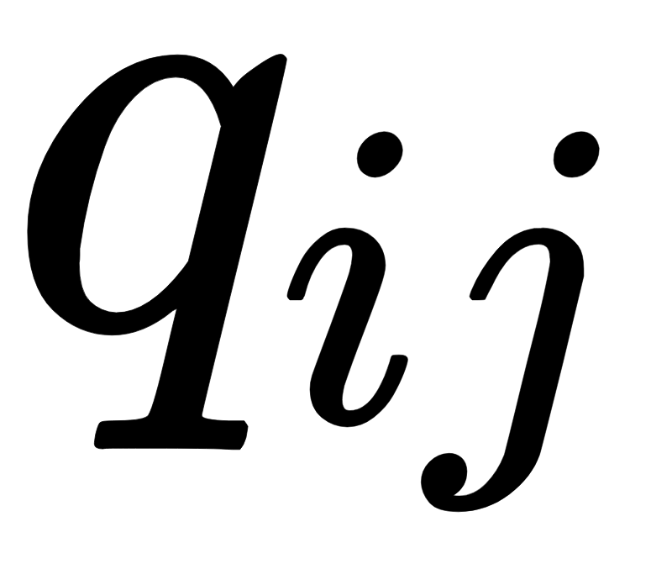
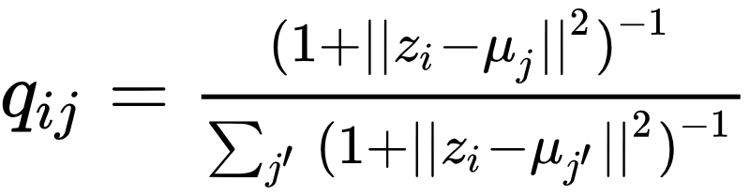
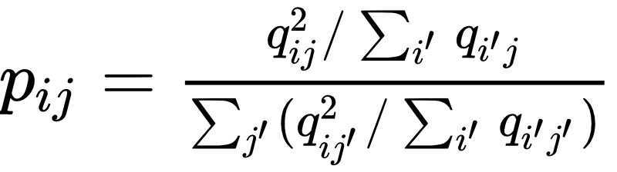
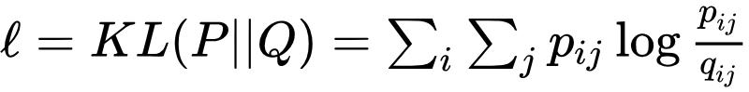
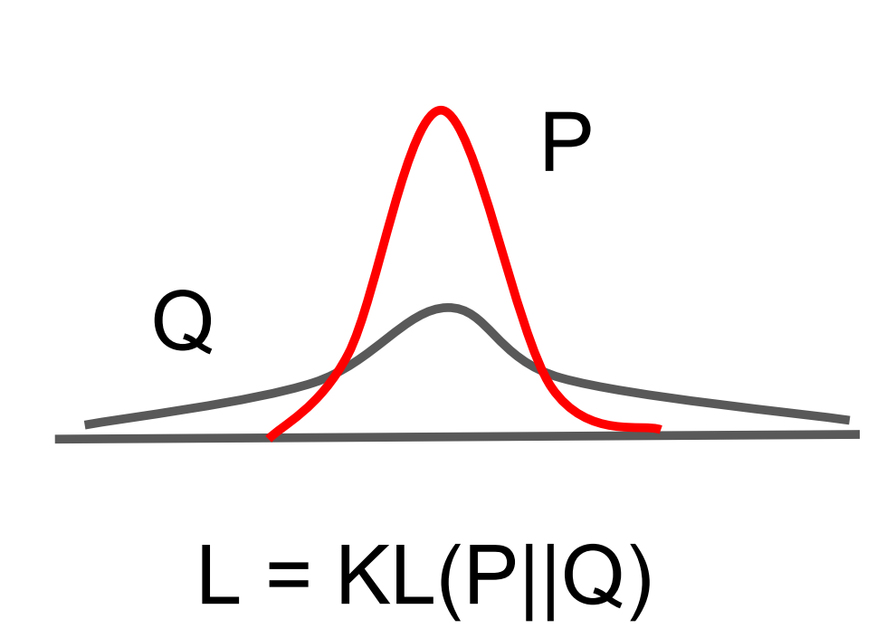
Phase II: Unsupervised clustering
and could be interpreted as the probability of trajectory i is assigned to cluster j
Current t-distribution:
Auxiliary distribution:
Loss function:
If q_{ij} is small, q_{ij}² will be even smaller
punish uncertain cluster assignments
high certain cluster assignments remain high
Minimizing the KL distance to compact the clusters
Notes:
Q is the current distribution of clusters (the probability of assigning every sequence to different clusters) and P is an auxiliary distribution that put more contribution on the high-confidence points. Minimize the KL distance will make the clusters more compact.
We minimize the KL distances a little bit for a few batches then update P and Q to finely change the clusters and assignments. The updating of P & Q means new high confidence points are trusted.
When the KL distance gets smaller, the cluster will get more compact. And the alg stops if the assignment do not change any more.

Slide 19
OUTLINE
Overview
Approach: DETECT
Convert trajectories to sequences of contexts
Fixed-size representation (embedding) with RNN
Embedding Clustering and Optimization
Experiments
Future Work

Slide 20
Experimental settings
Dataset: GeoLife
17,621 trajectories (601 labeled).
6 labels: “dining activities”, “working commutes”, etc.
14,000 POIs in Beijing
Evaluation Metrics
With label: Rand Index (RI), Mutual Information (MI), Purity Fowlkes-Mallows Index (FMI)
Without label: Silhouette Score, Dunn index, Within-like Criterion, Between-like Criterion

Slide 21
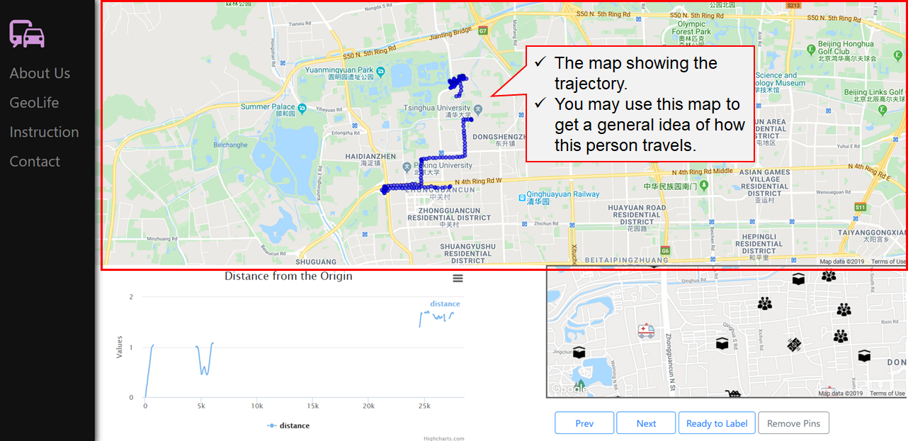
Labeling Platform

Slide 22
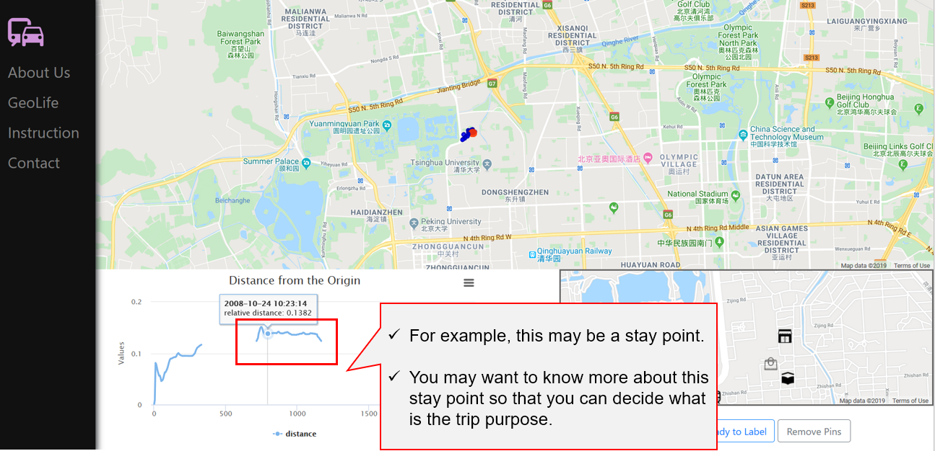
Labeling Platform

Slide 23
With-label: quantitative results
Distance
Clustering
Method | RI | MI | Purity | FMI
KM-DBA | 0.33 | 0.64 | 0.58 | 0.58
DB-LCSS | 0.22 | 0.55 | 0.51 | 0.56
RNN-AE | 0.39 | 0.46 | 0.56 | 0.53
SSPD-HCA | 0.52 | 0.93 | 0.66 | 0.67
KM-DBA* | 0.51 | 0.91 | 0.74 | 0.63
DB-LCSS* | 0.5 | 0.95 | 0.64 | 0.66
DETECT Phase I | 0.65 | 1.06 | 0.84 | 0.73
DETECT | 0.76 | 1.26 | 0.89 | 0.81
DTW
K-Means
LCSS
DBSCAN
SSPD
Hierarchical clustering
RI (Rand Index) (0,1)
MI (Mutual Information) (0, inf)
Purity (0,1)
FMI (Fowlkes-Mallows Index) (0,1)
Higher values for all metrics mean better results.

Slide 24
With-label: quantitative results
Method | RI | MI | Purity | FMI
KM-DBA | 0.33 | 0.64 | 0.58 | 0.58
DB-LCSS | 0.22 | 0.55 | 0.51 | 0.56
RNN-AE | 0.39 | 0.46 | 0.56 | 0.53
SSPD-HCA | 0.52 | 0.93 | 0.66 | 0.67
KM-DBA* | 0.51 | 0.91 | 0.74 | 0.63
DB-LCSS* | 0.5 | 0.95 | 0.64 | 0.66
DETECT Phase I | 0.65 | 1.06 | 0.84 | 0.73
DETECT | 0.76 | 1.26 | 0.89 | 0.81
Raw trajectories
Augmented trajectories
RI (Rand Index) (0,1)
MI (Mutual Information) (0, inf)
Purity (0,1)
FMI (Fowlkes-Mallows Index) (0,1)
Higher values for all metrics mean better results.

Slide 25
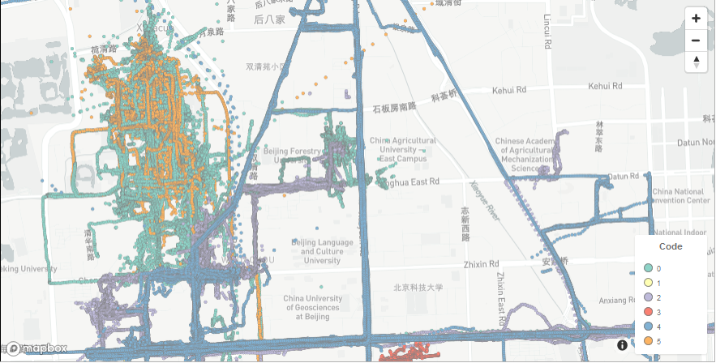
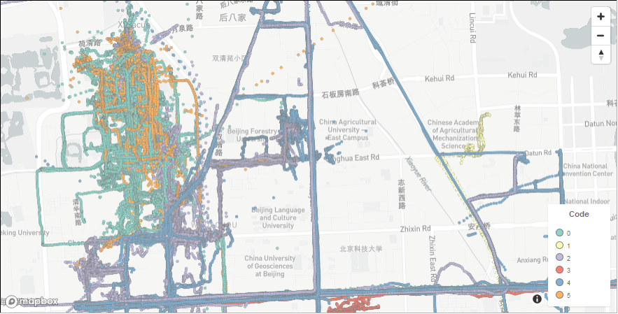
With-label: qualitative results
Ground Truth
Our Results
Colors indicate different clusters.

Slide 26
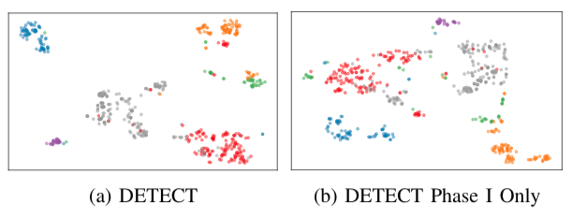
With-label: qualitative results
Embedding after Phase I
Embedding after Phase II

Slide 27
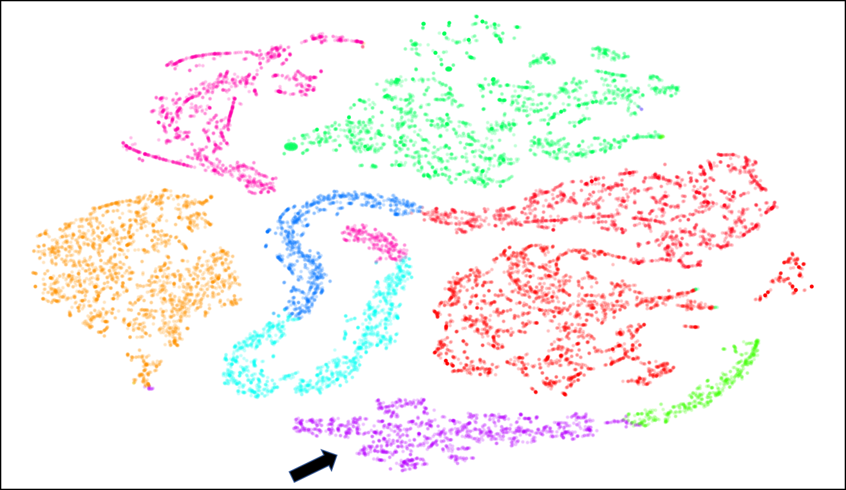
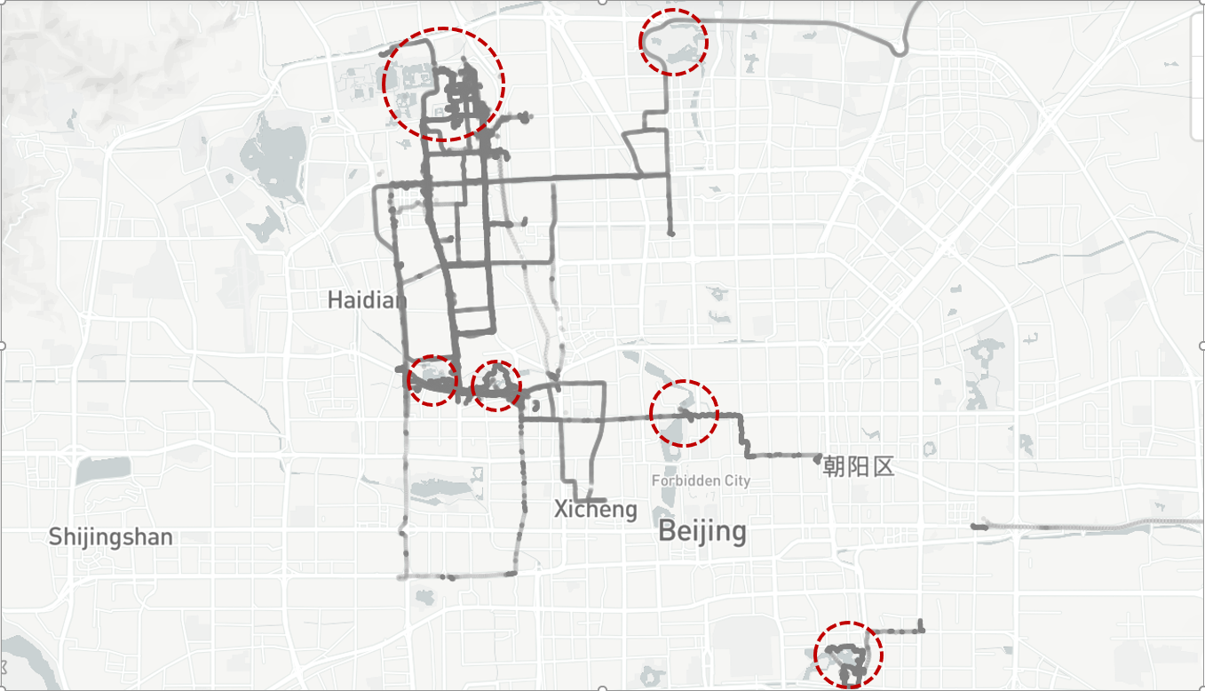
Without-label: qualitative results
Embedding of the full dataset
Recreation Activities

Slide 28
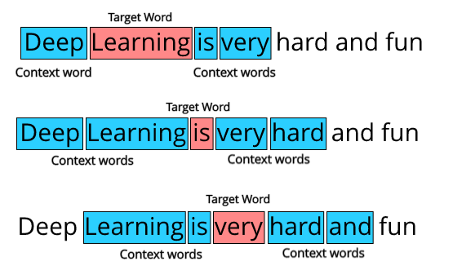


DETECT Extension: context learning
What if we don’t have a gazetteer for the area, e.g., boat trajectories?
Idea: Learn the context from trajectories. [ECML 20]
Sequence of words
Sequence of locations
Notes:
We had a relative study in delivery problem. The basic intuition is the trajectories are sequences of locations, which are similar to sequences of words, sentences. So the word embedding approaches may help us learn the location context from trajectories.

Slide 29
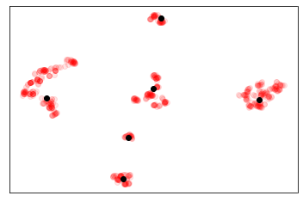
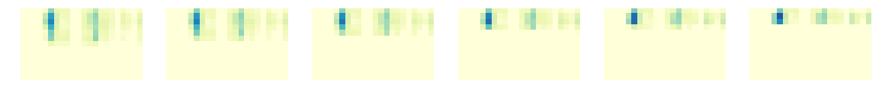
Also, one-phase generative model
Using a generative model to directly learn a cluster-aware hidden space rather than a 2-phase procedure
Can also be used for synthetic trajectory creation and anomaly detection
Directly learns a cluster-aware hidden space
Embedding by generative model
Interpolation between two augmented trajectories
Notes:
The generative model can directly learn a cluster-aware hidden space rather than a 2-phase procedure. And the representation is of good quality, i.e., nicely separated (left figure) and have meaningful interpolation after a little disturbance (right bottom). The interpolation is actually interpolating in the hidden space and all the figures are the decoded sequences from the interpolated hidden vectors. Remove if too complicated.

Slide 30
Future Work: Explainability
How to generate meaningful (explainable) embeddings to explain the clustering results
provide semantic meanings of individual clusters
understand outlier trajectories

Slide 31
NGA High Dimensional Nearest Neighbor (2021 – 2023)
Building a unified system for efficiently indexing and matching high-dimensional, massive, heterogeneous global reference data and image features for geolocating image data taken at ground level
UMN: Heterogeneous Geographic Data Fusion using Knowledge Graphs
USC ISI: Domain-Aware Representation Learning for Multi-Modal Geographic Knowledge Graphs
USC ISI: Fast Indexing and Matching

Slide 32
Heterogeneous Geographic Data Fusion using Knowledge Graphs
Prior Work
Mapping heterogeneous data sources into knowledge graphs
Integrating heterogeneous geographic datasets, e.g.,
Automatic uncertainty-aware, alignment of vector and raster data (a past NGA project)
Develop new capabilities for
Linking geographic features describing the same thing but from heterogeneous data sources
Exploiting existing data and the complementary nature of heterogeneous data sources to derive new geographic features or their attributes
System and Method for Fusing Geospatial Data, Chen, C.-C., Knoblock, C. A., Shahabi, C., and Chiang, Y.-Y. US Patent No. 7660441

Slide 33
Other Ongoing Work

Slide 34

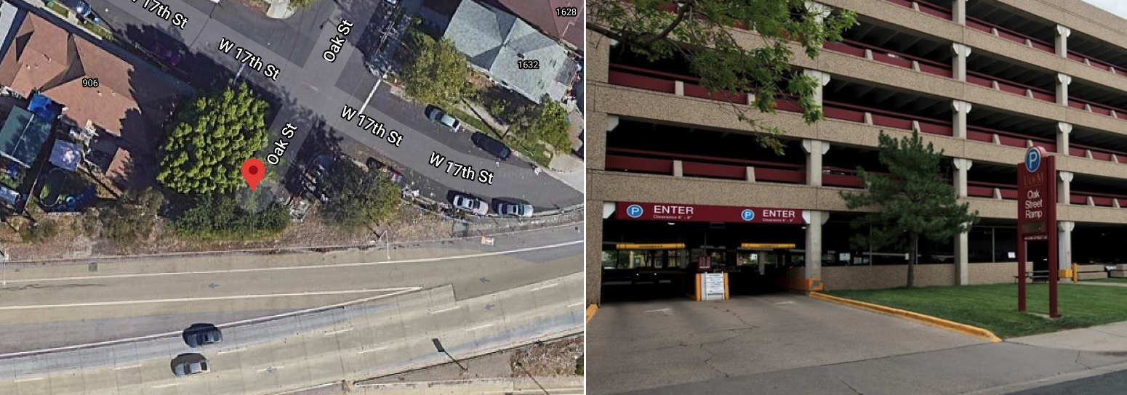
GeoBERT
How to efficiently extract
named geo-entities (NGEs),
entity attributes, and
relations (when available) from Natural Language data
and then mapping the extracted information to a knowledge graph (KG) to support various GEOINT tasks
in Los Angeles, a “ramp” often refers to a highway entrance or exit, but a ramp is colloquially known as a covered parking structure without walls in Minneapolis. Therefore, the sentence “I parked my Honda Civic on the Oak Street ramp.” would have very different implications (for the two cities) that are difficult to capture using only text corpora.

Slide 35

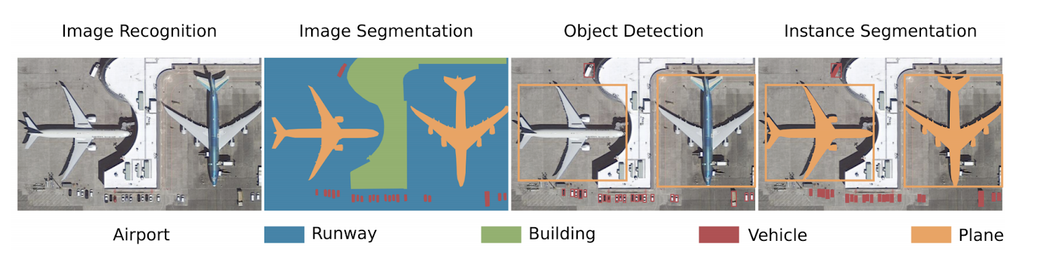

EarthScan
How to effectively exploit prior knowledge of things in space for
Detecting objects from overhead imagery using reduced numbers and varieties of annotated visual samples, and
Parsing overhead imagery into complete geographic layers

Slide 36

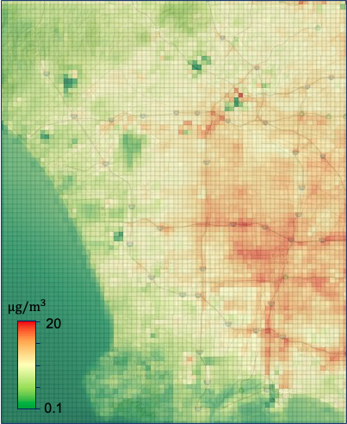
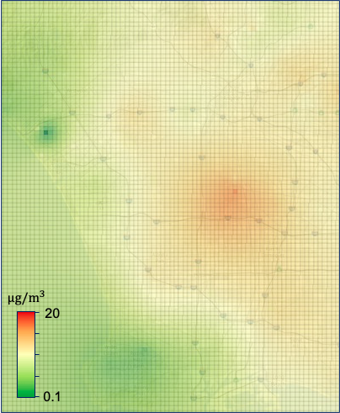
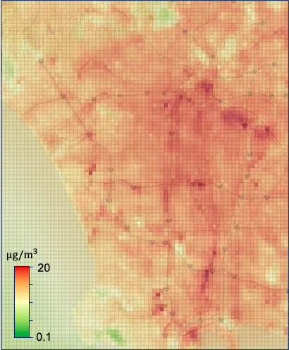
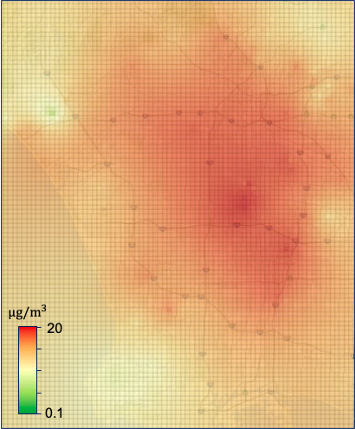
DeepLATTE:
How to effectively forecast heterogeneous multi-scale time-series data to detect outliers and provide insights into human activities
Data sources include ground sensors, remotely sensed imagery, etc.
Griffith Park
Intersection of 110 and 10
105
110
710
Feb. 2019, Our Model
Feb. 2019, Ordinary Kriging
Oct. 2019, Our Model
Oct. 2019, Ordinary Kriging

Slide 37
Thank you!
Discussion

Slide 38
References
[BigData 19] Yue M, Li Y, Yang H, Ahuja R, Chiang YY, Shahabi C. DETECT: Deep Trajectory Clustering for Mobility-Behavior Analysis. In Big Data 2019.
[ECML 20] Yue M, Sun T, Wu F, Wu L, Xu Y, Shahabi C, Learning a Contextual and Topological Representation of Areas-of-Interest for On-Demand Delivery Application, ECML-PKDD 2020
[ITS 16] Besse, Philippe C., et al. "Review and perspective for distance-based clustering of vehicle trajectories." IEEE Transactions on Intelligent Transportation Systems 17.11 (2016): 3306-3317.
[AIR 17] Yuan, Guan, et al. "A review of moving object trajectory clustering algorithms." Artificial Intelligence Review 47.1 (2017): 123-144.
[ICDM 14] Petitjean, François, et al. "Dynamic time warping averaging of time series allows faster and more accurate classification." 2014 IEEE international conference on data mining. IEEE, 2014.
[CVPR 09] Morris, Brendan, and Mohan Trivedi. "Learning trajectory patterns by clustering: Experimental studies and comparative evaluation." 2009 IEEE Conference on Computer Vision and Pattern Recognition. IEEE, 2009.
[SIGSPATIAL 08] Li, Quannan, et al. "Mining user similarity based on location history." Proceedings of the 16th ACM SIGSPATIAL international conference on Advances in geographic information systems. ACM, 2008.

